Slide 1
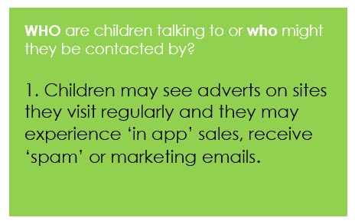
Parenting In The Digital Age
PITDA recommends the WWW approach to make sure you know:
WHO your child is talking to online, WHAT they’re doing online, and WHERE they’re going online
Notes:
An unplugged discussion activity
Get Involved:
Find out what your child is doing online
You always know where they are in the physical world so know where online.
Try to locate technology where you can see it and be involved- get them to show you-be more familiar with their online world
Agree rules as a family about personal information, time spent online, and contacting people via the internet.
Create a family email address for registering online?
Have a contract with your child about mobile phone use
Encourage children to behave as they would in the physical world

Slide 2
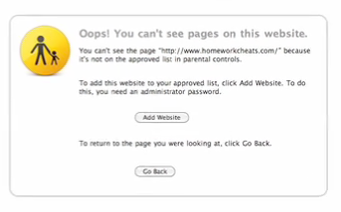
Take action:
Risk assess:
Where are the devices?
What can they do?
Can your child get online in his / her bedroom?
Have you enabled any parental settings on devices or the internet as it comes into the house?
Disable or cover webcams to avoid accidental sharing of images
Link children’s email addresses to yours so you receive a copy of their emails
Use child friendly search engines for the younger children
Turn off Wi-Fi when you don’t want it to be used
Notes:
Hidden unless needed
Be aware of technical capabilities…wifi, tethering, mobile data…etc.
Try to locate the computer where you can see it and not in bedrooms with closed doors.
Let them be the expert telling you and showing you what they are doing
Ask questions, be interested not nosey, find out who they are interacting with online
Discussing the opportunities and risks with children involves helping them to see for themselves how they might get into and out of difficulty.
Create a family email address for registering online?
Remind them that the online world is an extension of the real world so they shouldn’t behave differently
Explore together how to use online content responsibly
Encourage them to acknowledge their research by
including web addresses at the end of homework

Slide 3
How To…
View browsing history
Set up parental controls on your TV
Set up parental controls on apple devices
Set up parental lock on BBC iPlayer
Set a Youtube safety mode
Find out more about parental controls
Notes:
Suggest this is done on school technology.

Slide 4
Click If You…
….. want to check out how safe sites, games and apps are
…need more information about online bullying
……are concerned about inappropriate contact
….need advice on smartphones and mobile apps
Need to report images that concern you
Need to report on any form of hate crime
Notes:
This will introduce parents to some of the main agencies supporting young people, parents and carers with esafety.
Could be supervised by session leader on main screen

Slide 5
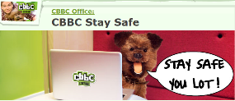
Be prepared:
Have a plan for when things do go wrong.
Know where to go for help and advice – including school!
Know what your school is doing and support and reinforce key messages
Find out what policies are in place in relation to e-safety
Notes:
Hidden unless needed
Be aware of technical capabilities…wifi, tethering, mobile data…etc.
Try to locate the computer where you can see it and not in bedrooms with closed doors.
Let them be the expert telling you and showing you what they are doingnicola
Ask questions, be interested not nosey, find out who they are interacting with online
Discussing the opportunities and risks with children involves helping them to see for themselves how they might get into and out of difficulty.
Create a family email address for registering online?
Remind them that the online world is an extension of the real world so they shouldn’t behave differently

Slide 6
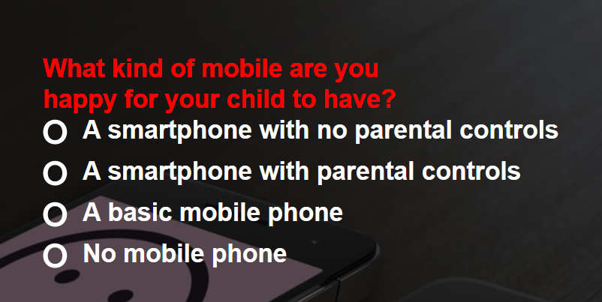
Switched On Families
http://keepup.virginmedia.com/switchedonfamilies
Notes:
Switched on Families Suggest this is done on mobile technology provided by the school
Guide parents to the Playbook

Slide 7
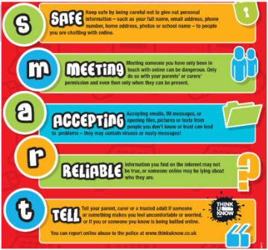
Some more practical steps you could take
“Sometimes it not about giving advice, sometimes it’s just about being there to listen to what they have to say” BeatBullying Mentor
Create a family email address for registering online?
Discuss how they might get into and out of difficulty
Locate technology where you can see it
Get them to show you what they are doing online
Agree as a family about time to be spent online…. mobile phone use
Encourage openness and provide informal opportunities to talk about online activity
Notes:
Hidden unless needed
Ask questions, be interested not nosey, find out who they are interacting with online
Create a family email address for registering online?
Remind- the online world is an extension of the real world so they shouldn’t behave differently
What else works for you that you can share?

