Slide 1
welcome to
Picasso CLASS
Year 5/6 - 2025/26
The PICASSO teaching TEAM
Mrs Jackson – class teacher
Mrs McCabe – teaching assistant

Slide 2
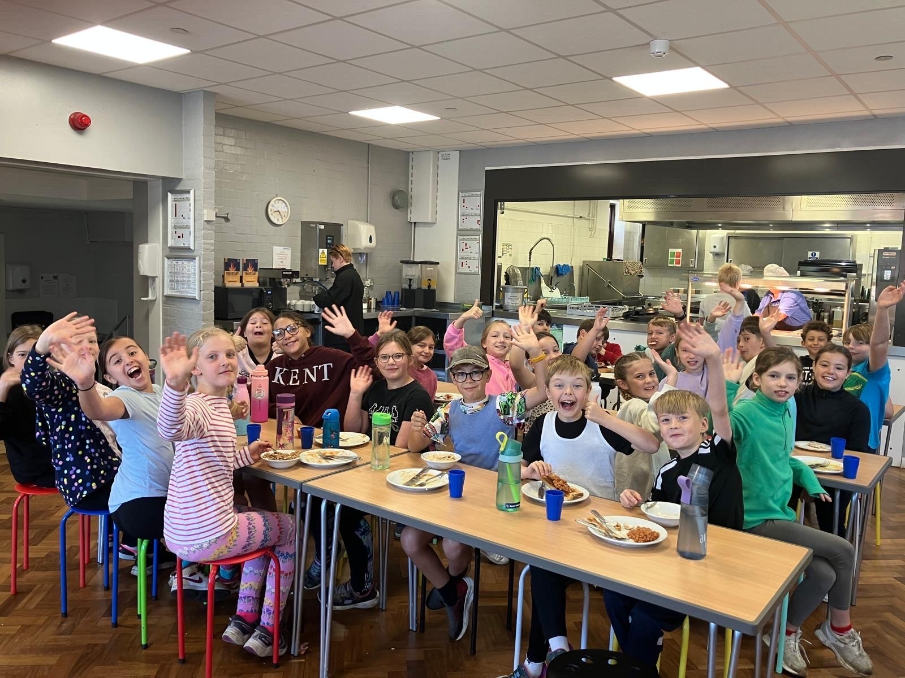
“Hello” from Picasso!

Slide 3
Our CLASS PRAYER
Dear God,
Please help us together,
to learn for life,
achieve our best
and grow in faith.
In Jesus’ name,
Amen

Slide 4
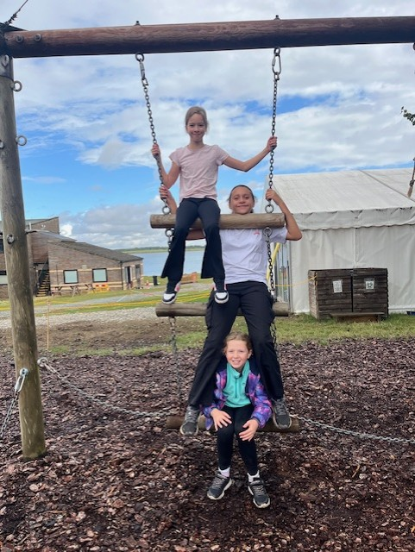
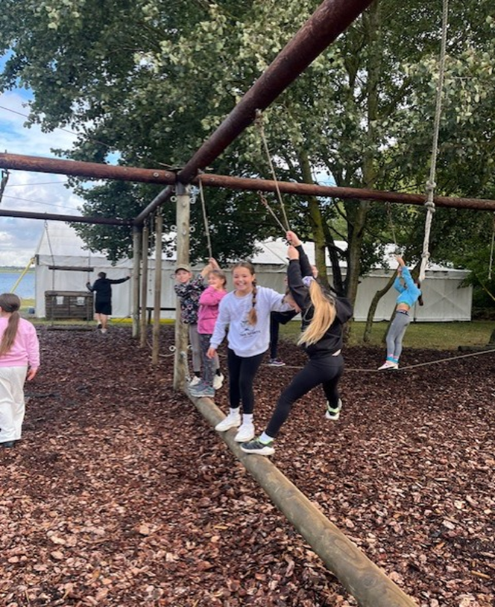
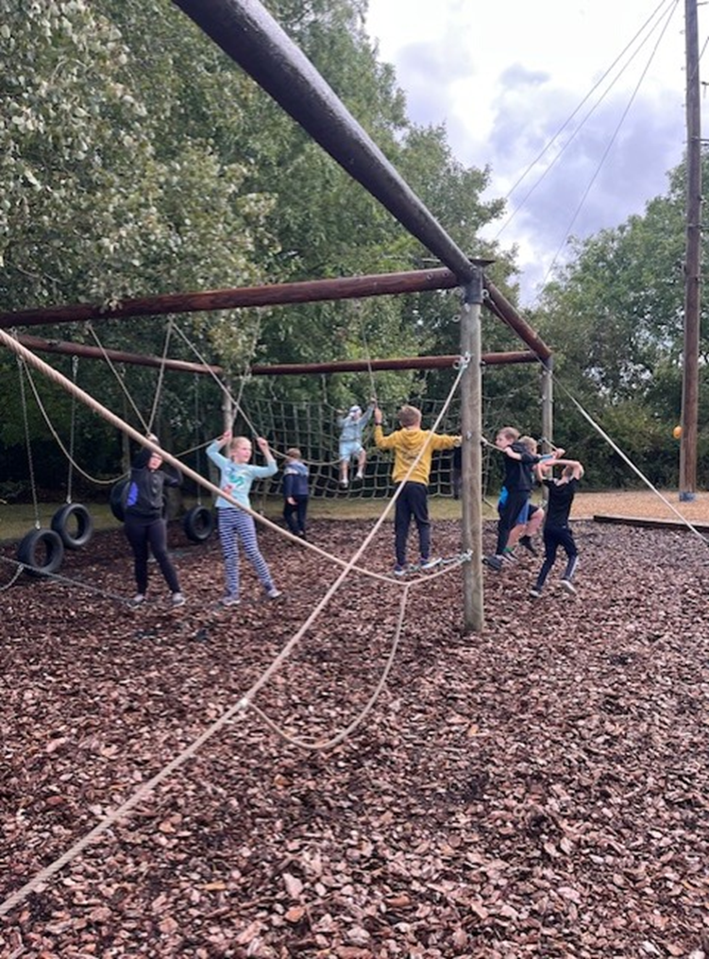
PICASSO AT GRAFHAM 2025!
LOW ROPES!

Slide 5
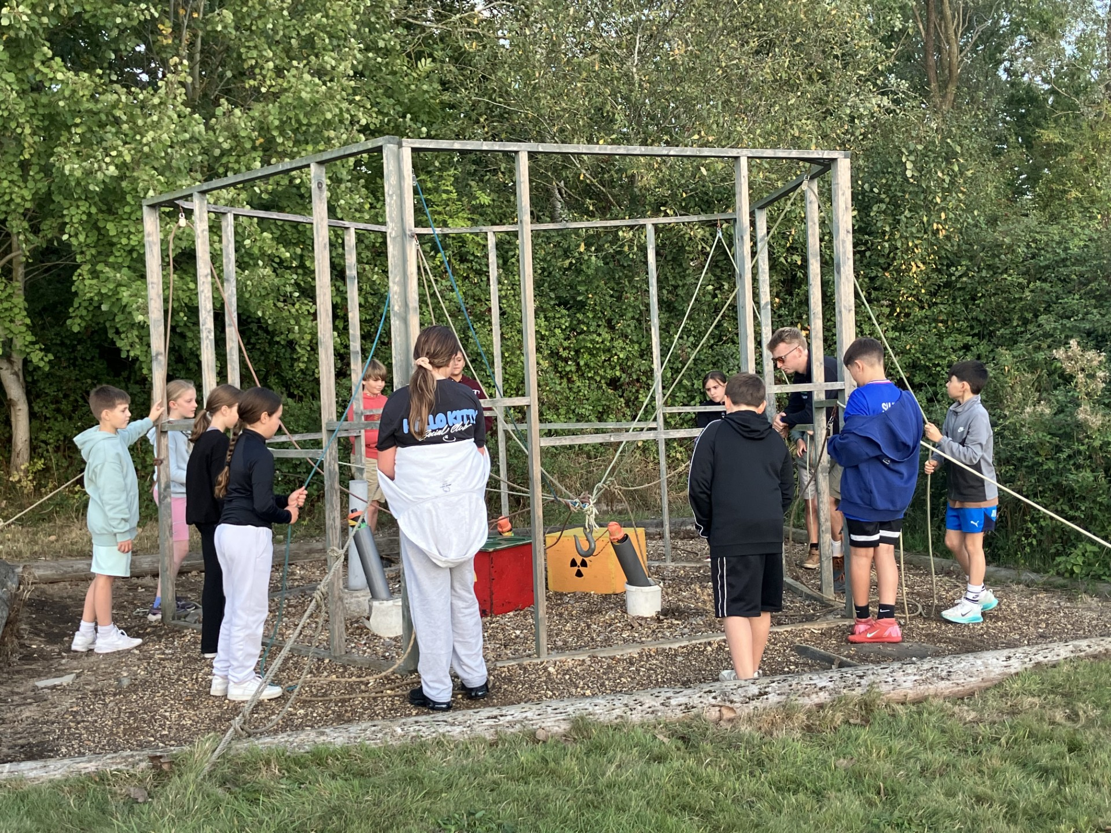
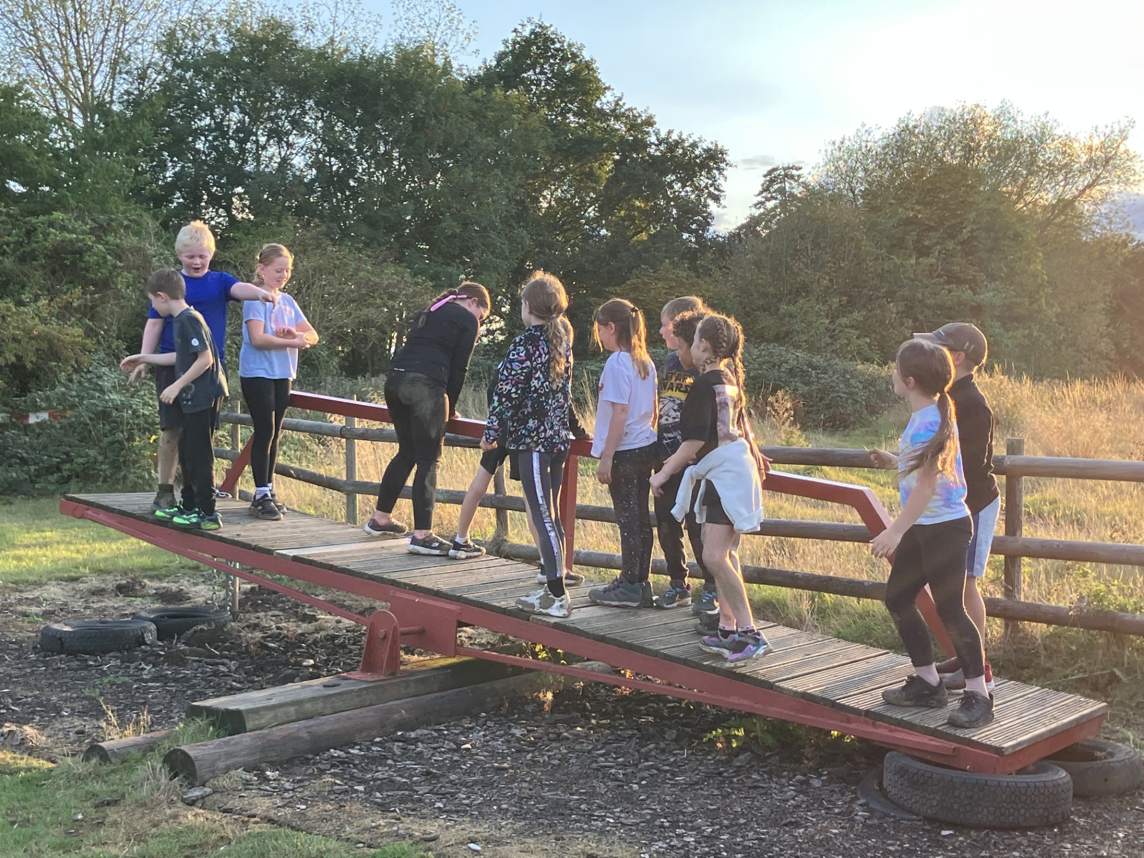
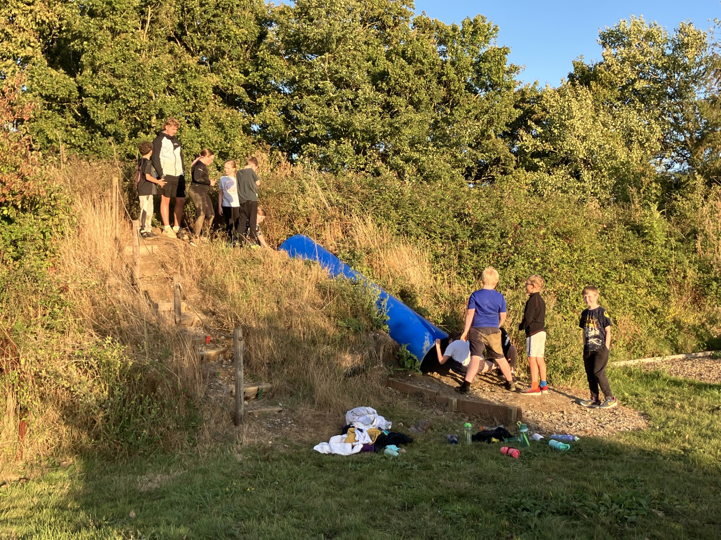
PROBLEM SOLVING!

Slide 6
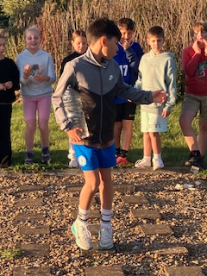
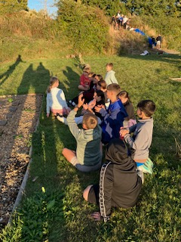
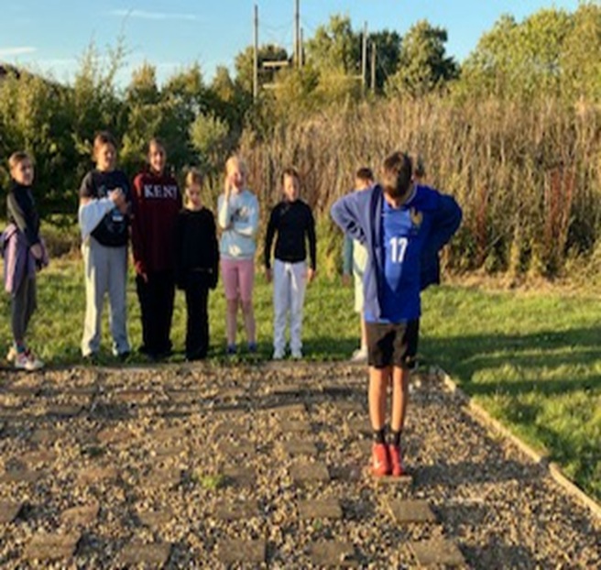

Slide 7
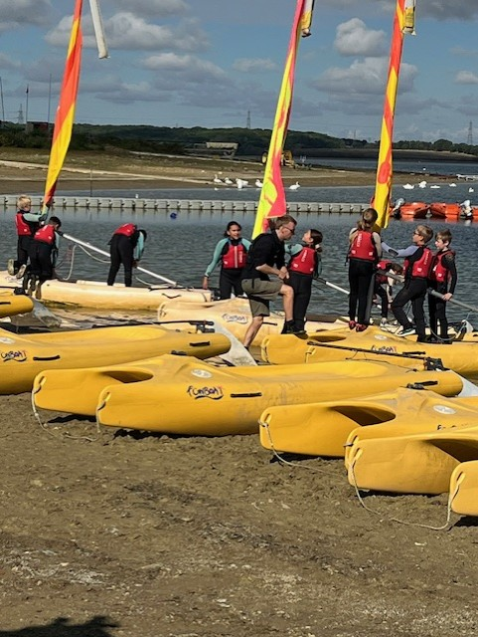
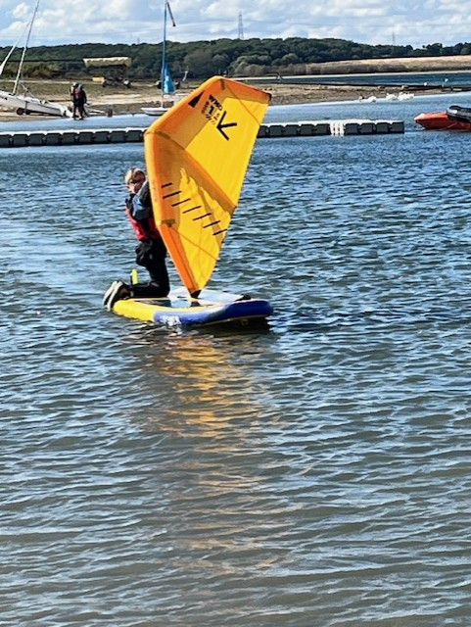
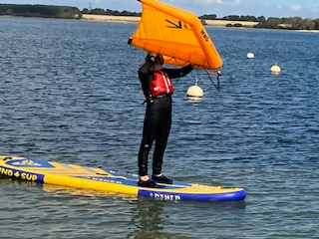
WING SURFING!

Slide 8
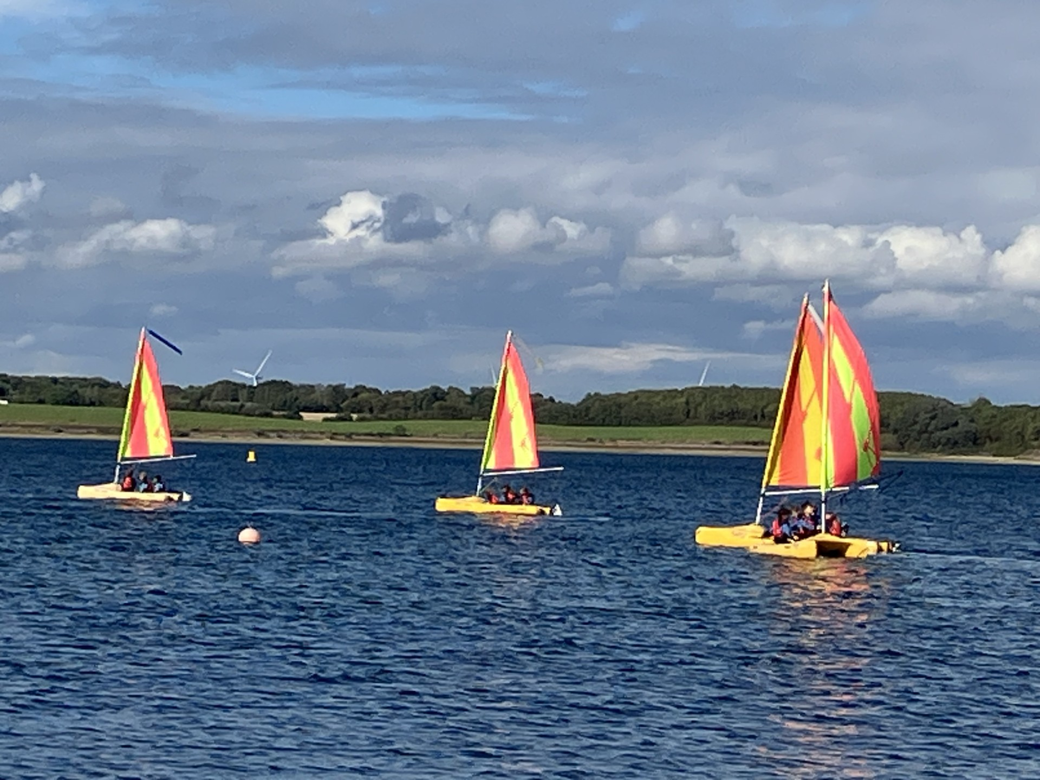
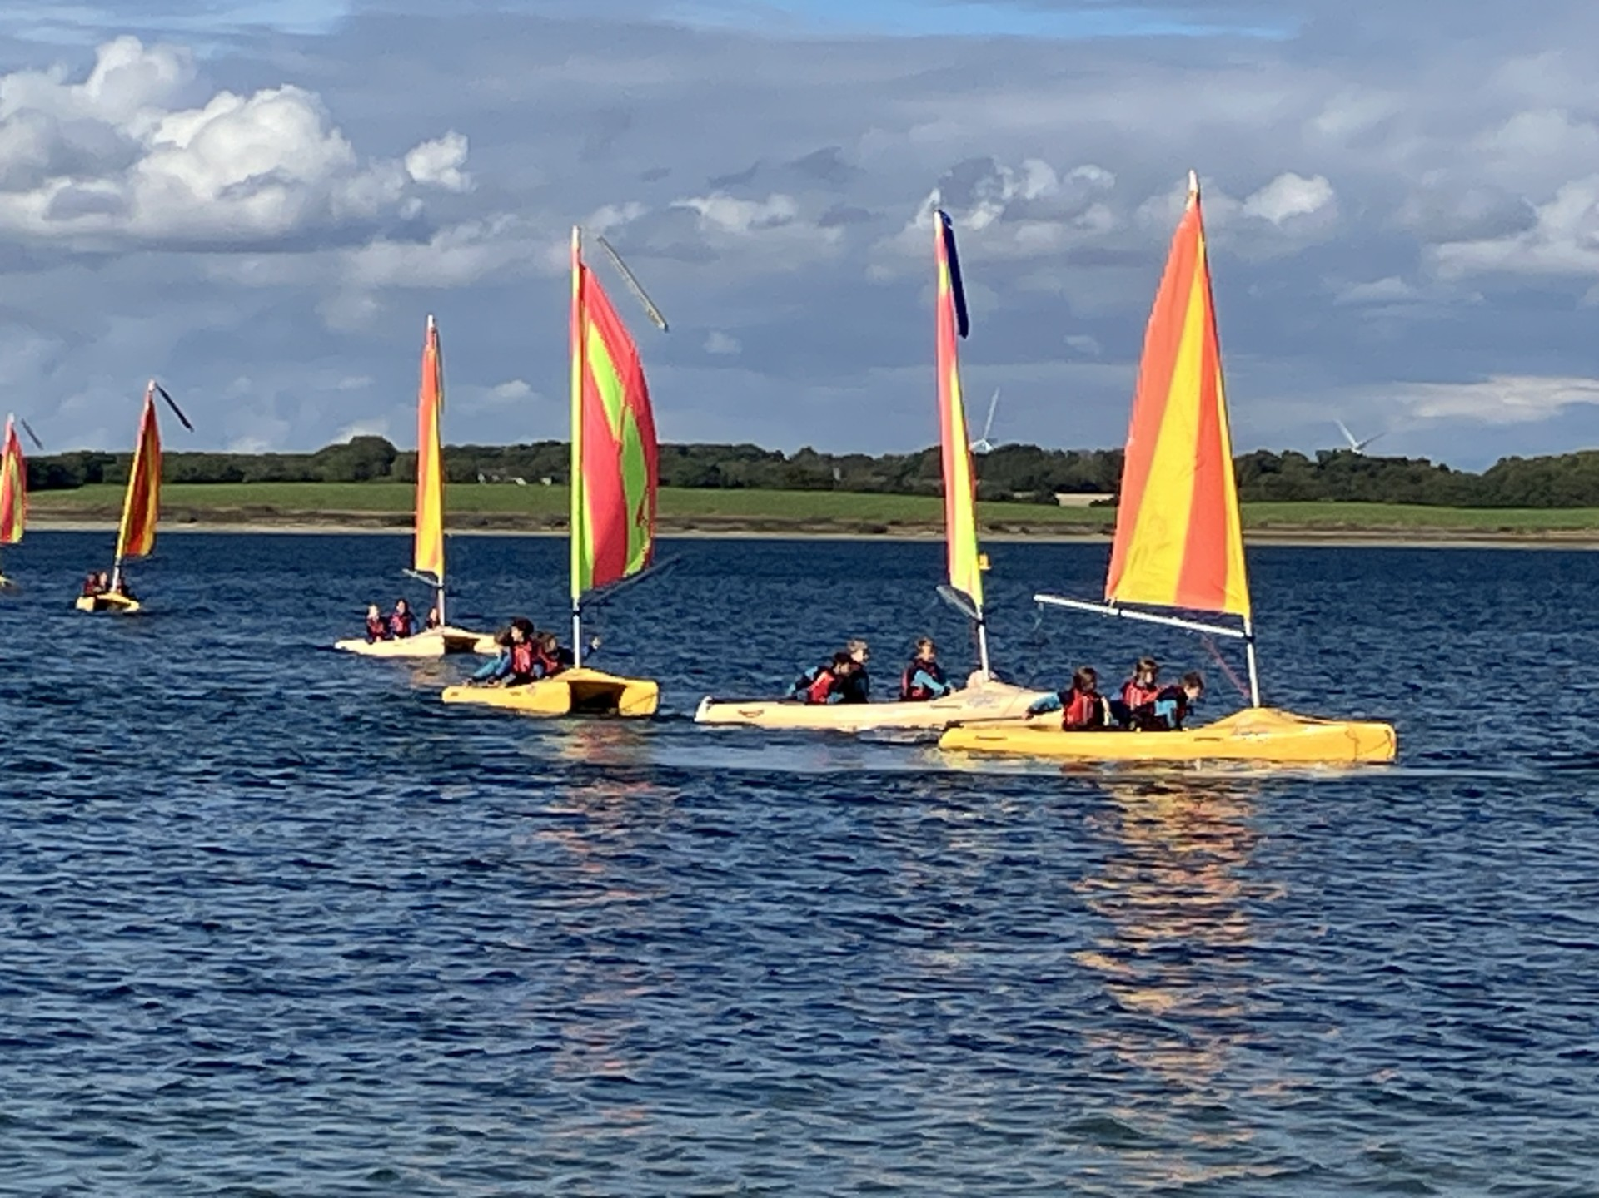
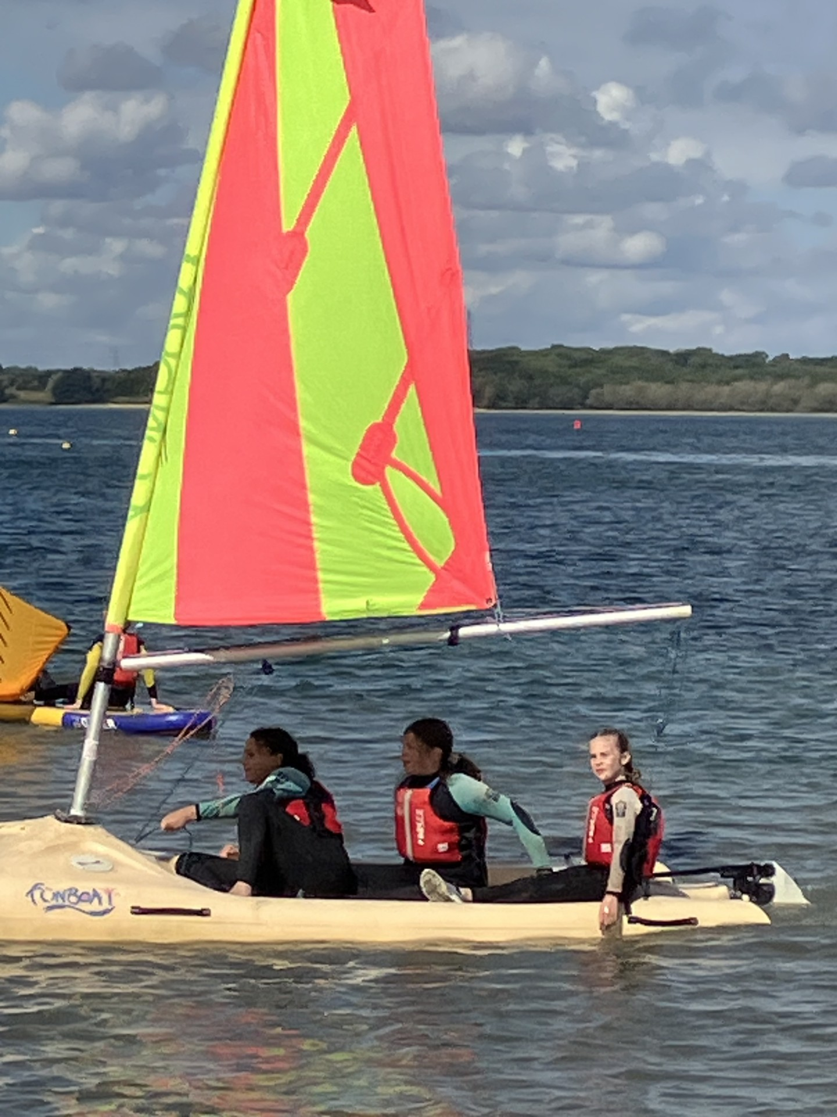
SAILING!

Slide 9
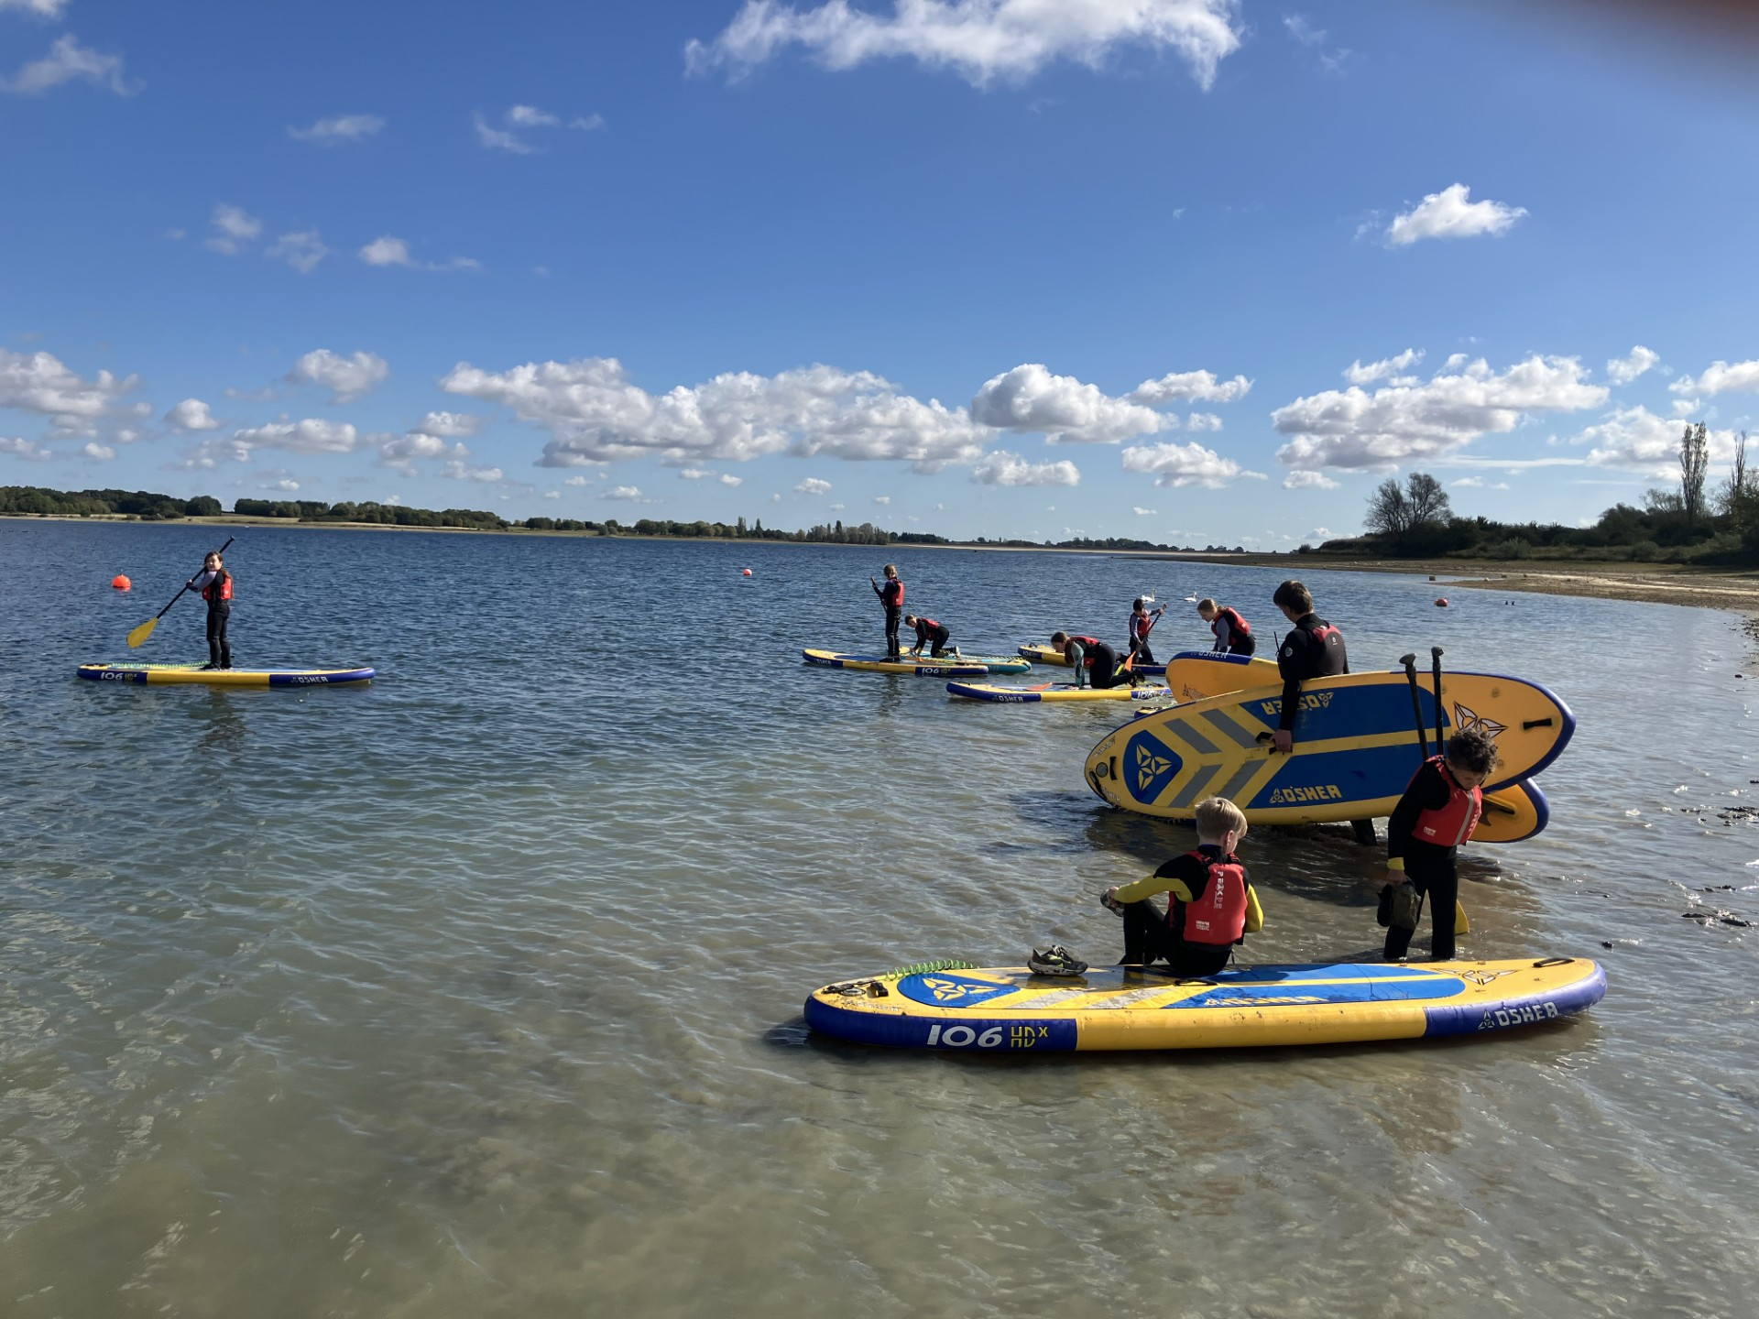
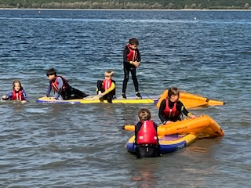
Paddleboarding!

Slide 10
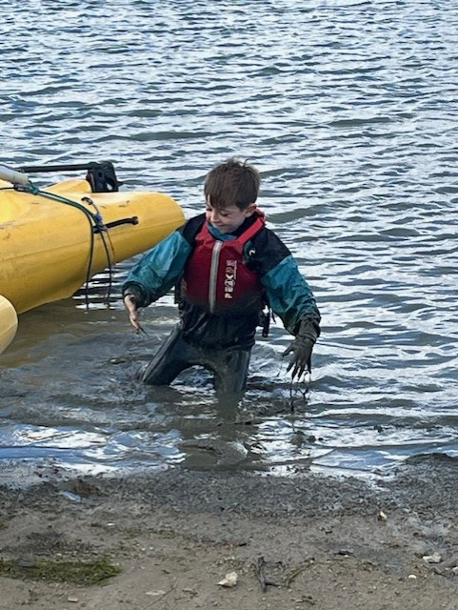
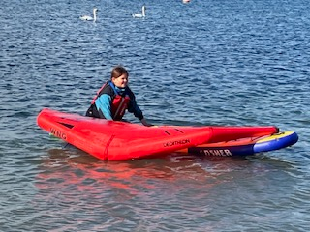
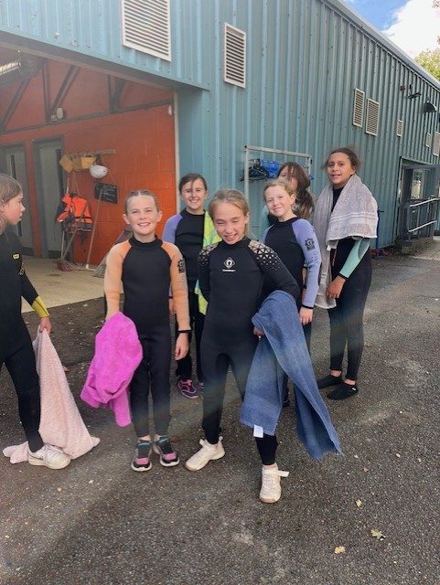
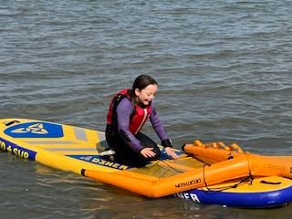
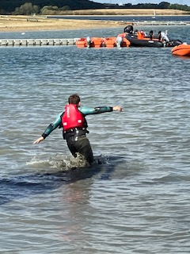
MUD!....WET!...DRY!

Slide 11
Weekly Reminders!
Monday – Water Bottles in
Monday pm – PE – Reminder for all children to come to school in full PE kit. Please remember no jewellery (earrings should be removed or covered) and long hair must be tied back
Friday – Water Bottles home
Everyday – Reading books in
Thank you

Slide 12
Collection ARRANGEMENTS
If your child is in Year 5 or 6 and you would like them to be allowed to leave the site unaccompanied i.e. they are allowed to walk home from school, please do let the office know so that you can sign the permission form.

Slide 13
FOR YEAR 6 ONLY
KS2 SATs (Statutory Assessment Tests) 2026
Monday 11th May 2026 to Thursday 14th May 2026
Monday 11 May 2026: English Grammar, Punctuation and Spelling:Paper 1: Grammar and Punctuation Monday 11 May 2026: English Grammar, Punctuation and Spelling: Paper 2: Spelling
Tuesday 12 May 2026: English Reading
Wednesday 13 May 2026: Mathematics Paper 1: Arithmetic
Wednesday 13 May 2026: Mathematics Paper 2: Reasoning
Thursday 14 May 2026: Mathematics Paper 3: Reasoning

Slide 14
Home learning
We would welcome the children continuing their learning beyond the classroom - if you do anything outside of school linked to our learning please do share this with us. In the past, children have visited museums to find out about a history topic or done some independent research. This really enhances topics for us all so please do encourage your child to share this with us.
Reading high quality texts is vital as this has such a positive impact on writing development. We have an excellent selection of books in class and reading every day for at least 15 minutes is an expectation for home learning in Picasso class.
TTRockstars is also a great resources provided by school and just 10 minutes each day will really improve vital skills in times tables including the inverse division facts.
Children will be given a Password Passport which will contain the passwords that they need.

