Slide 1
SATs Information
Picasso Class
Year 6
March 2020

Slide 2
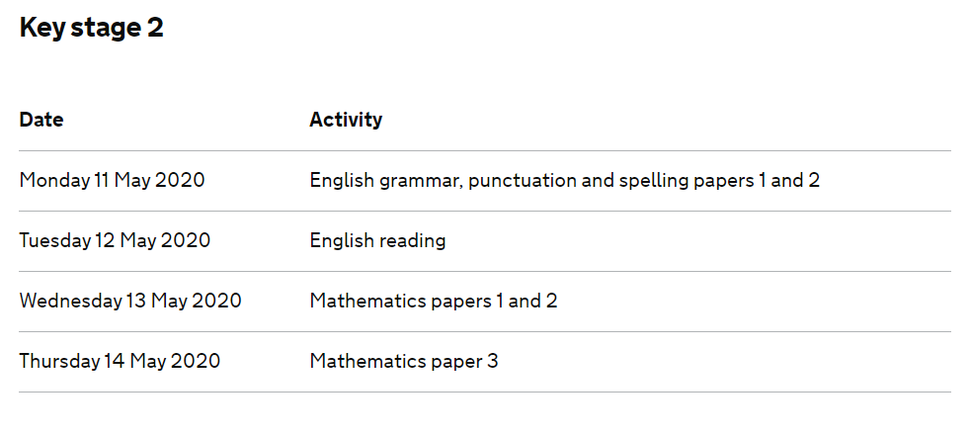
SATs Timetable

Slide 3
Grammar, Punctuation and Spelling
A separate test is given on Punctuation, Vocabulary and Grammar.
This lasts for 45 minutes and requires short answer questions, including some multiple choice. (50)
A Spelling test (Paper 2) is then administered containing 20 words, lasting approximately 15 minutes. (20)
Marks for these two tests are added together to give a total for Spelling, Punctuation and Grammar. Total of 70 marks.

Slide 4
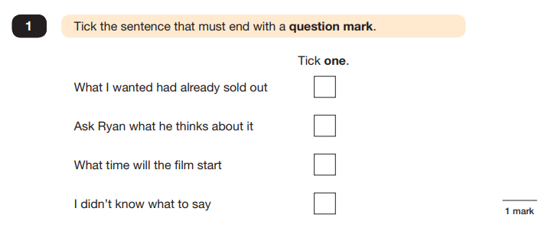
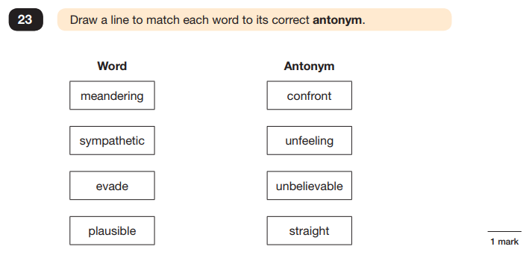
Paper 1: Punctuation, Vocabulary and Grammar

Slide 5
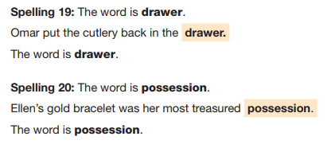
Paper 2: Spelling
Pupils will have a transcript looking like this:
Words will be read
to pupils in this format:

Slide 6
Reading
The Reading Test consists of a single test paper with three unrelated reading texts.
Children are given 60 minutes in total, which includes reading the texts and answering the questions.
A total of 50 marks are available.
Questions are designed to assess the comprehension and understanding of a child’s reading.
Some questions are multiple choice or selected response, others require short answers and some require an extended response or explanation.

Slide 7
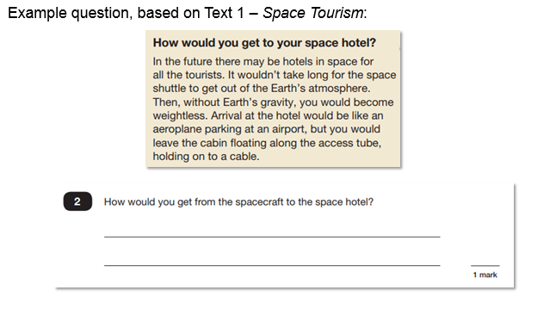

Slide 9
Mathematics
Children will sit three tests: Paper 1, Paper 2 and Paper 3.
Paper 1 is for ‘Arithmetic’ lasting for 30 minutes, covering calculation methods for all operations, including use of fractions, percentages and decimals.
Questions gradually increase in difficulty. Not all children will be expected to access some of the more difficult questions later in the paper.
Papers 2 and 3 cover ‘Problem Solving and Reasoning’, each lasting for 40 minutes.
Pupils will still require calculation skills but will need to answer questions in context and decide what is required to find a solution.

Slide 10
Maths Marks:

Slide 11
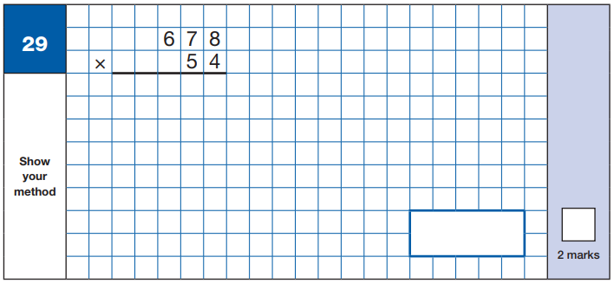
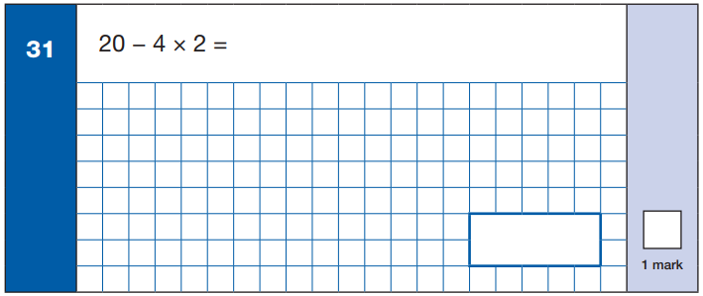
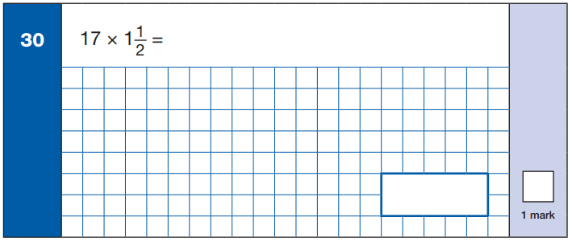
Arithmetic Paper

Slide 12
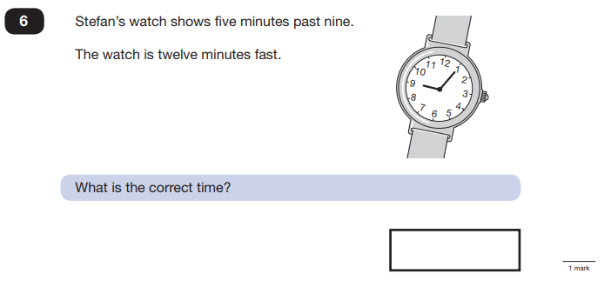
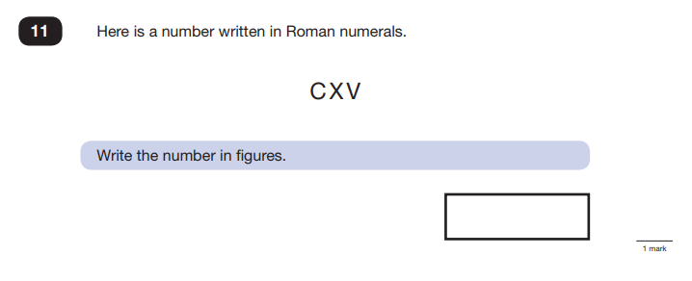
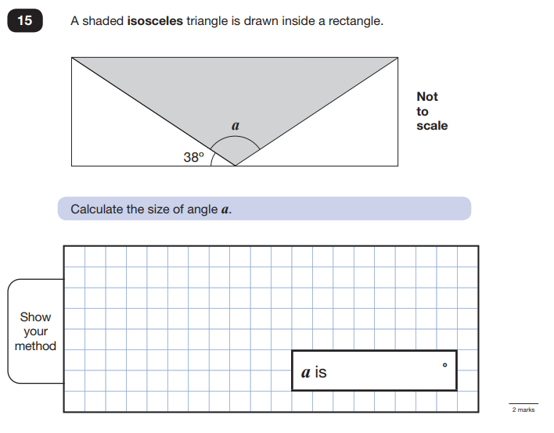
Reasoning Papers

Slide 13
Assessment and reporting
Scaled Scores
What is meant by ‘scaled scores’?
Scaled scores go from 80 to 120 and a score of 100 will always represent the ‘national standard’.
Each pupil’s raw test score will therefore be converted into a score on the scale.
In July, your child will receive:
A raw score (number of raw marks awarded).
A scaled score in each tested subject.
Confirmation of whether or not they attained the national standard.
Further information:
A child awarded a scaled score of 100 is judged to have met the ‘national standard’ in the area judged by the test.
A child awarded a scaled score of 110 or above is judged to have exceeded the national standard and demonstrated a higher than expected knowledge of the curriculum for their age.
A child awarded a scaled score of 99 or less is judged to have not yet met the national standard and performed below expectation for their age.

Slide 14
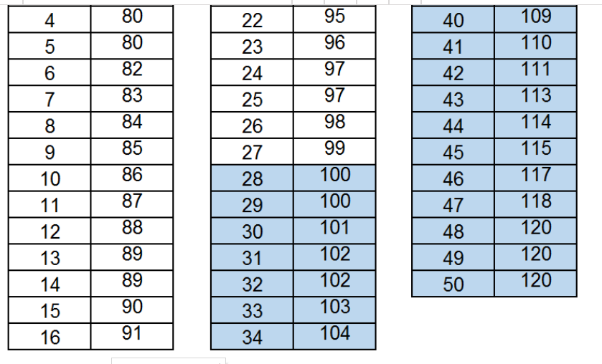
Example of scale scores – 2019 Reading Data:

Slide 15
Try these Tips at home for a stress free approach to revision
First and foremost support and reassure your child that there is nothing to worry about and they should always just try their best. Praise and encourage!
Ensure your child has the best possible attendance at school.
Support your child with any Home Learning tasks and Revision tasks set.
Reading, spelling and arithmetic (e.g. times tables) are always good to practise.
Talk to your child about what they have learned at school and what book(s) they are reading (the character, the plot, their opinion).
Make sure your child has a good sleep and healthy breakfast every morning! We will provide a breakfast club for Year 6 during the test week too so make use of that if it is easier.
Stay positive and help them to plan their time or to get the help they need.
Plan treats suggest a family treat each week or at the end of the tests to give your child something to look forward to. Let them choose what they would like. We will be treating them in school too!
Make time for fun - remember to still have a laugh together.
Try to encourage your child to have set periods of time for revision utilising online resources – TT Rock Stars, Mathletics and SPAG.com

