Slide 1
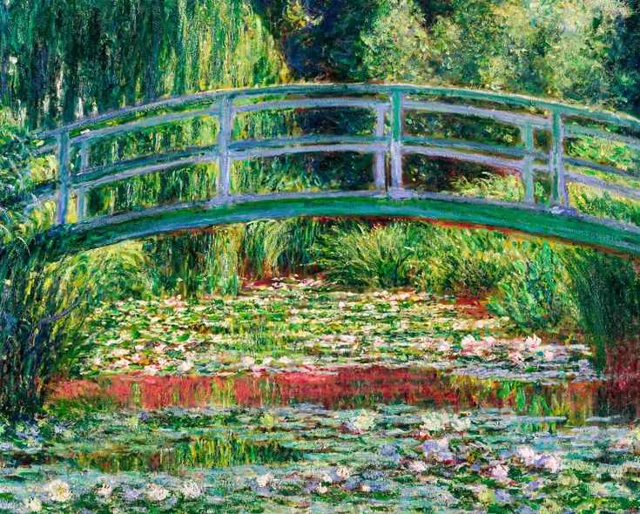
Welcome to
Monet Class!
Year 1 and 2

Slide 2
Our class prayer is based on our school vision.
Dear God,
Please help us to learn for life, achieve our best and grow in faith.
In Jesus’s name.
Amen

Slide 3
Teaching Staff:
Class Teachers
Mrs MacLeod
Monday – Wednesday
Mrs Oakins
Thursday – Friday
Support staff
Mrs Gibbons
Miss Handscombe
Mr Heather – PE
Mrs Jackson – Science
Mrs Gibbons – Computing

Slide 4

Physical Education
This will usually take place on Tuesday and Friday
A few reminders for PE:
Please can children come to school ready for PE with the correct kit for full participation.
Children should currently be wearing a white t-shirt, black shorts and suitable shoes for indoor/outdoor sport.
In cold weather they may also need plain black jogging bottoms and jumper.
• Long hair must be tied back.
• No jewellery please – Necklaces, friendship bracelets etc.
• Earrings should be removed completely and only covered with tape in exceptional circumstances.

Slide 5

Classroom Routines
Please bring your book bag and reading diary into school everyday for sharing notes on reading and important messages.
Reading books can be changed first thing every morning or when you have finished the book. Children will have an e-book released on a Thursday to be read online at least 3 times.
Water bottles should be brought to school every Monday and they will sent home on a Friday. This is to be water only please.
Pease send in wellies in a named plastic bag to be kept in school.
Please send your child to school with a waterproof coat everyday as we will be out in all weathers.
Bags – to maximise space in the cloakroom and minimise items being brought into school, pupils will only require a book bag and not a rucksack.
Please send in a small change of clothes that can be kept on your child’s peg in a named plastic bag. This will prevent the borrowing of clothes following an accident.

Slide 6
Learning in Monet Class
Throughout Key Stage 1 we learn in a variety of ways:
First hand experiences and exploration allowing opportunities for independence and decision making with adult guidance.
Guided Groups with focused delivery from teaching staff
Whole class teaching and learning. There are also opportunities for pupils to receive individual feedback as necessary.
Assessment
Observations, assessments and work gathered throughout the year help to assess your child against the end of Key Stage One curriculum framework.

Slide 7
Home Learning
Please do read every day for at least 15 – 20mins. This can involve sharing a book, listening to your child read or an adult reading to the child.
Home tasks to support school-based learning:
• Practise mathematical facts – making use of Mathletics. (Log in details to follow. They will be placed in the front of the children’s reading diaries). This is important consolidation for the children. It should not take longer than 15 mins a week.
• Year 2 can also use Times Tables Rockstars. (Log in details will be stuck in the front of the children’s reading diaries.) Again this is crucial to supporting the vital skill of times tables.
• Phonics (see next page)
• Practise Tricky Words; first reading them and then spelling.

Slide 8


Reading
In Monet Class, we love to read! Everyday, we enjoy sharing a range of books in class. We listen to our teacher read, we read to each other and complete our Reading Practise Sessions.
Following our in-school Reading Practise Sessions (Monday-Wednesday) we will send home the title of your child’s e-book in their Reading Diary. Please encourage your child to read on-line a minimum of three times. These texts will remain in your child’s online library for you to return to at anytime.
In order to support your child’s reading, we complete regular diagnostic assessments so that we can accurately match your child’s knowledge and skills to the relevant set of books.
Your child will bring home a Shared Reading Book each night. We hope that you enjoy sharing these with your child – it could be a non-fiction book, a comic or a picture book story.

Slide 9


Phonics
Please practise the sounds from each phase that your
child is working on currently:
Year 1 - Phase 3 and 4. Phase 5 after October half term.
Year 2 - Phase 5
Ideally, this will be with the Little Wandle GPC cards and tricky words. If you would like to purchase a
set from school please let the office know.
Mrs MacLeod will be running Little Wandle Phonics, Reading and Spelling workshops for parents this term.
Year 1 - Thursday 9th October at 8:45am.
Year 2 - Thursday 23rd October at 8.45am. Beyond Phase 5 presentation.

Slide 10

Behaviour
In Monet Class, we reward positive learning and behaviour by moving our peg up to the moon and stars, and receiving a token.
The children can choose which reward box they would like to put their token in.
At the end of every half term, we count the tokens and the whole school celebrates with the chosen reward.
We continue to award certificates on a Friday and we also give out stickers from time to time.

Slide 11
We have thoroughly enjoyed getting to know your children over the last week and we are looking forward to a great year ahead!
Please do come and say hello if you haven’t already. We look forward to working with you throughout the year.

