Slide 1
Introduction to
Year 1 Spelling and Phonics
Home Learning
Parent Workshop
9th October 2025

Slide 2
Terminology
Blend- combine broken up sounds to make a word
Ex: sh-or-t → short
Segment- separating a word into its individual sounds
Ex: short → sh-or-t
Adjacent Consonants- two or more consonants that appear next to each other in a word
Ex: fr in frog, st in stop, cl in clap
Split diagraph- two letters that represent one sound but are split by a consonant
Ex: a-e in mane
Prickly Words- formerly known as ‘tricky words’ but because the children have learned the unusual graphemes in these word, the words can be decoded.
Phoneme – a sound in a word
Ex: /ee/ /ay/
Grapheme- letter or letters that represent a sound
Ex: ai, ch, or, igh, ough
Digraph- two letters that represent one sound
Ex: ee, le, ay
Trigraph- three letters that represent one sound
Ex: igh, ear, air
Quadgraph- four letters that represent one sound
Ex: ough, aigh, eigh

Slide 3
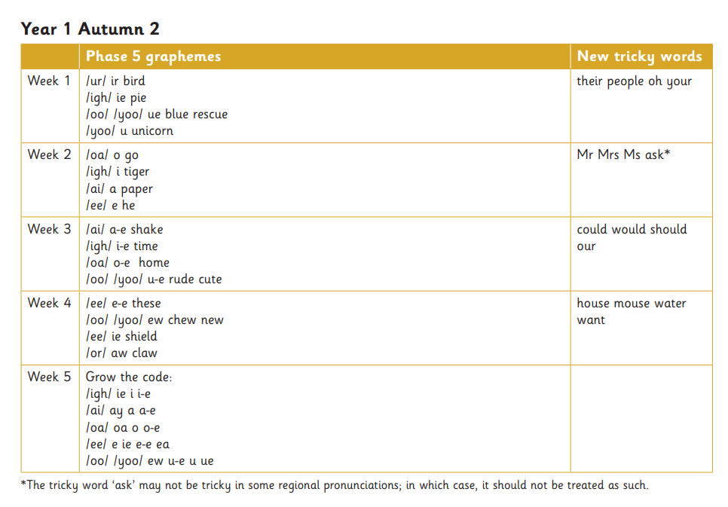
Notes:
We’ve come to the point in our spelling journey where we move away from an overt teaching of what letter patterns or graphemes make certain sounds, to explicit teaching of spelling rules.

Slide 4
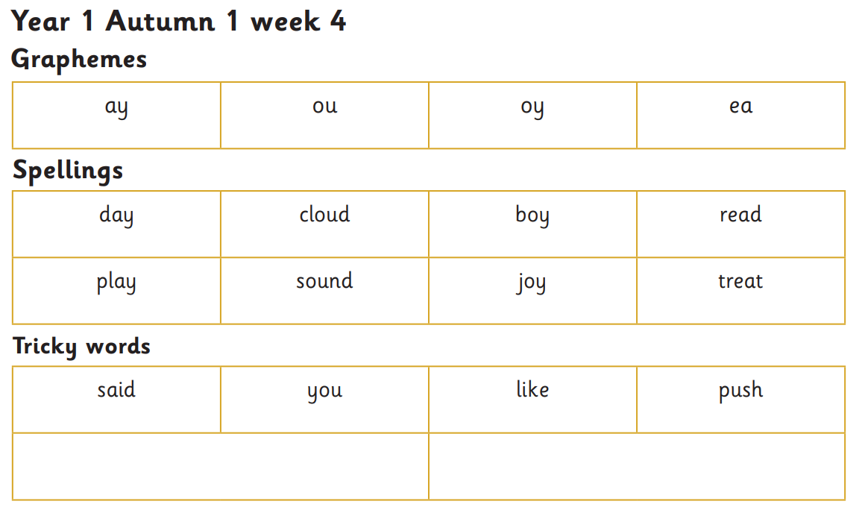
Spelling Books
New word lists will be added to spelling books every Thursday.
Words should be practised throughout the week in preparation for a quick quiz the following Thursday.
Say sounds
Add sound buttons
Or sound bars
Practise tricky words

Slide 5
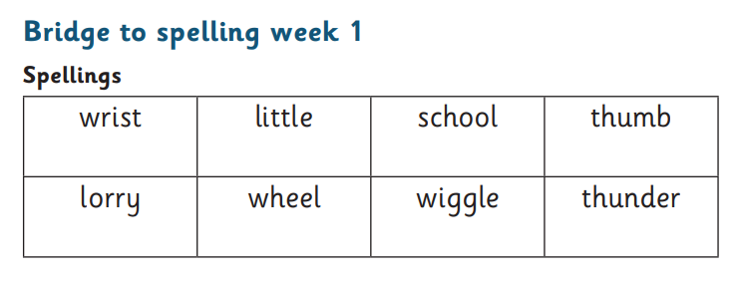
Ask your child to:
Read the words
Add the sound buttons (dots and dashes)
Write the words in their spelling book
Cover the words and practise in the book (encourage your child to ‘segment before you spell’)

Slide 6
What a spelling book might look like:
Day 3
Day 1
rist little skool thumb
lorry wheel wigle thunder
wrist wrist wrist wrist
school school school school
wiggle wiggle wiggle wiggle
wrist school wiggle
Day 2
wrist little school thumb
lorry wheel wiggle thunder
Day 4

Slide 7
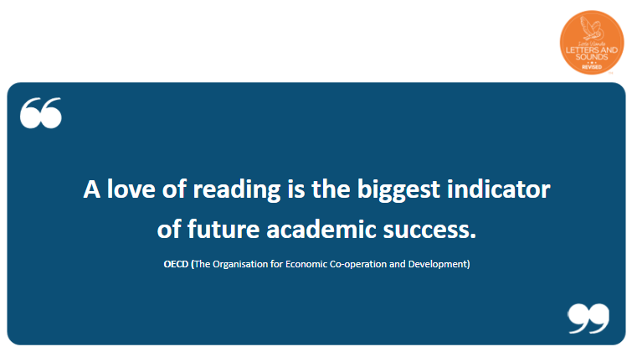
Notes:
Show shared book basket, explain that children choose their own books from this curated set. We choose the genres based on future English units. For example, currently the children are choosing from traditional tales because they will shortly be writing their own traditional tale. The more exposure to the genre before writing, the more prepared they’ll be to write.

Slide 8
Questions or Clarification

