Slide 1
Introduction to
Year 2 Spelling and
Grow the code
Phonic Progression
Parent Workshop
23rd October 2025

Slide 2
Terminology
Blend- combine broken up sounds to make a word
Ex: sh-or-t → short
Segment- separating a word into its individual sounds
Ex: short → sh-or-t
Adjacent Consonants- two or more consonants that appear next to each other in a word
Ex: fr in frog, st in stop, cl in clap
Split diagraph- two letters that represent one sound but are split by a consonant
Ex: a-e in mane
Prickly Words- formerly known as ‘tricky words’ but because the children have learned the unusual graphemes in these word, the words can be decoded.
Phoneme – a sound in a word
Ex: /ee/ /ay/
Grapheme- letter or letters that represent a sound
Ex: ai, ch, or, igh, ough
Digraph- two letters that represent one sound
Ex: ee, le, ay
Trigraph- three letters that represent one sound
Ex: igh, ear, air
Quadgraph- four letters that represent one sound
Ex: ough, aigh, eigh

Slide 3
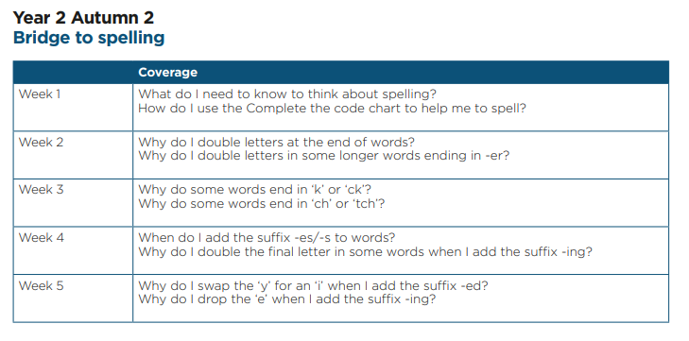
Notes:
We’ve come to the point in our spelling journey where we move away from an overt teaching of what letter patterns or graphemes make certain sounds, to explicit teaching of spelling rules.

Slide 4
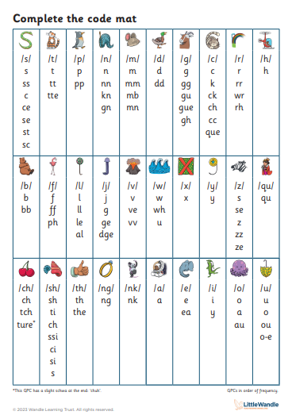
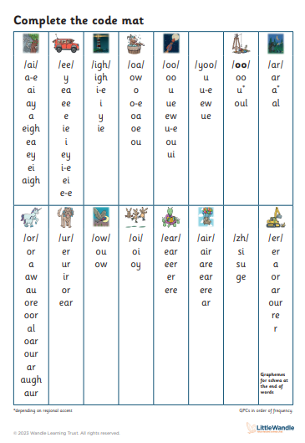

Slide 5
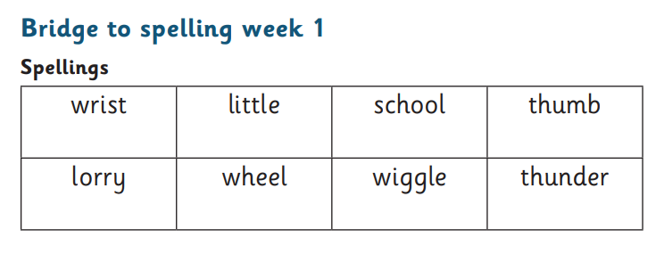
Spelling Books (will begin coming home at half term)
New words will be added to spelling books every Friday.
Words should be practised throughout the week in preparation for a quick quiz the following Friday.

Slide 6
Ask your child to:
Read the words
Add the sound buttons (dots and dashes)
Write the words in their spelling book
Cover the words and practise in the book (encourage your child to ‘segment before you spell’)

Slide 7
What a spelling book might look like:
Day 3
Day 1
rist little skool thumb
lorry wheel wigle thunder
wrist wrist wrist wrist
school school school school
wiggle wiggle wiggle wiggle
wrist school wiggle
Day 2
wrist little school thumb
lorry wheel wiggle thunder
Day 4

Slide 8
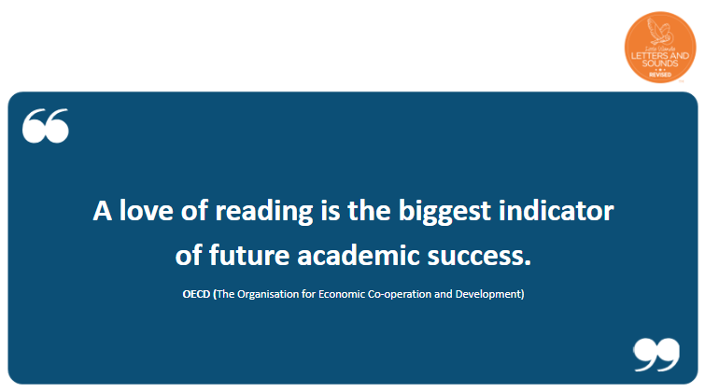
Notes:
Show shared book basket, explain that children choose their own books from this curated set. We choose the genres based on future English units. For example, currently the children are choosing from traditional tales because they will shortly be writing their own traditional tale. The more exposure to the genre before writing, the more prepared they’ll be to write.

Slide 9
Reading Progression (from next half term)
Path A
Your child continues with Little Wandle E-books as they have been.
Children read the book 3 times in school.
Books are uploaded by Thursday each week. Your child should read the book at home up to 3 times to develop maximum fluency.
All children should be able to read this book independently with little or no help from an adult.
Path B
Your child will leave the Little Wandle Reading Program after passing the fluency assessment and move on to colour banded books.
A colour (level) will be assigned after an individual reading assessment.
Your child will choose their reading books from the school’s colour banded library.
The books will be a hard copy and come home daily with your child’s shared reading book. As your child progresses on their reading journey, colour banded books may become the only book they bring home. This book should still be read aloud to an adult.
Colour banded books can be changed as frequently as your child would like.
Notes:
Your child’s reading path will be discussed with you at parent consultations next week.

Slide 10
Path B continued
Children will move from LW Reading Practice sessions to 3 Guided Reading sessions.
These sessions will take place three times a week and focus on comprehension; particularly:
*vocabulary
*retrieval
*sequencing
*inference
Guided Reading texts will not come home, all work around the text will be done at school.

Slide 11
Questions or Clarification

